Slide 1
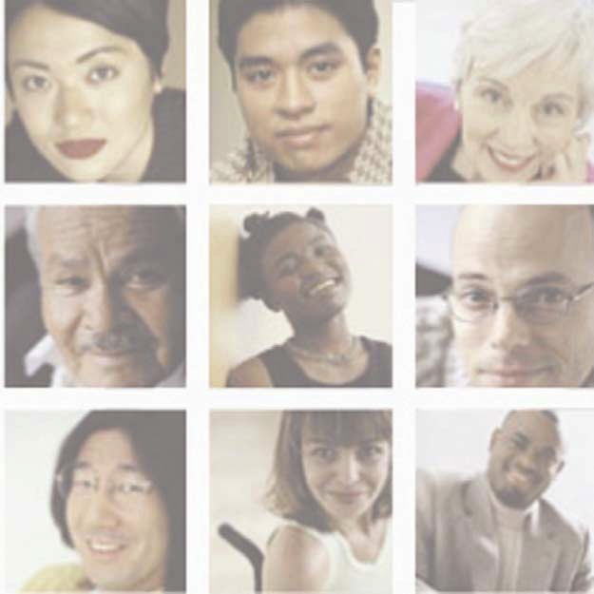
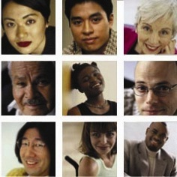
Criminal Justice Reform
MI 2208 Race, Poverty & Biblical Justice
Dr. Craig Hendrickson

Slide 2
Marijuana Use & Arrest Rates
Between 2001-2010, there were 8 million marijuana arrests in the US; 88% for possession. 52% of all drug arrests and marijuana possession 46% of all drug arrests.
In 2010, states spent 3.6 billion enforcing marijuana possession laws.
Black people were 3.73x more likely to be arrested for marijuana possession than a white person.
-Black arrest rate: 716 per 100,000
-White arrest rate: 192 per 100,000
In 2015, FBI crime stats reveal that more than ¼ of drug arrests were of Black people

Slide 3
Marijuana Use by Race
In 2010, 39.26% of Americans had used marijuana in their lifetime (National Survey on Drug Use & Health)
In 2011, 42.2% of Americans had used marijuana in their lifetime (WHO Survey of Nations)
in 2010, 14% of Black people and 12% of White people reported using marijuana in the last year
In every year between 2001-2010, more white than black people between 18-25 reported using marijuana in the past year
In 2010, more than 34% of white people and 27% of Black people reported using marijuana more than one year ago, while 59% Black and 54% White reported having never used it

Slide 4
What’s the Point?
The war on drugs has largely been a war on people of color.

Slide 5
The Sentencing Project (2018)
African American adults are 5.9x more likely to be incarcerated than whites.
Hispanics adults are 3.1x more likely to be incarcerated than whites
2001—1/3 of African American boys, 1/6 Latino boys, 1/17 white boys could expect to go to prison in their lifetime
In 2016, 27% of all arrests in the US were black people (twice their pop); black youth 35% of all juvenile arrests (15% of pop)
African Americans and Latinos comprise 29% of US population, but 57% of US prison population
Notes:
African Americans are more likely than white Americans to be arrested; once arrested, they are more likely to be convicted; and once convicted, and they are more likely to experience lengthy prison sentences.

Slide 6
Why? Five Contributing Reasons…
Discretionary stops
Pretrial Detention
Biased use of discretion
Policies that disadvantage people of color
Policies that disadvantage poor people
Notes:
In recent years, police are more likely to stop black and Hispanic drivers for discretionary reasons—for “investigatory stops” (proactive stops used to investigate drivers deemed suspicious) rather than “traffic-safety stops” (reactive stops used to enforce traffic laws or vehicle codes). Nationwide surveys also reveal disparities in the outcomes of police stops. Once pulled over, black and Hispanic drivers were three times as likely as whites to be searched (6% and 7% versus 2%) and blacks were twice as likely as whites to be arrested. These patterns hold even though police officers generally have a lower “contraband hit rate” when they search black versus white drivers.
Pretrial detention has been shown to increase the odds of conviction, and people who are detained awaiting trial are also more likely to accept less favorable plea deals, to be sentenced to prison, and to receive longer sentences. Seventy percent of pretrial releases require money bond, an especially high hurdle for low-income defendants, who are disproportionately people of color. Blacks and Latinos are more likely than whites to be denied bail, to have a higher money bond set, and to be detained because they cannot pay their bond. They are often assessed to be higher safety and flight risks because they are more likely to experience socioeconomic disadvantage and to have criminal records. Implicit bias also contributes to people of color faring worse than comparable whites in bail determinations.
Prosecutors are more likely to charge people of color with crimes that carry heavier sentences than whites. Federal prosecutors, for example, are twice as likely to charge African Americans with offenses that carry a mandatory minimum sentence than similarly situated whites.38) State prosecutors are also more likely to charge black rather than similar white defendants under habitual offender laws
Drug-free school zone laws mandate sentencing enhancements for people caught selling drugs in designated school zones. The expansive geographic range of these zones coupled with high urban density has disproportionately affected residents of urban areas, and particularly those in high-poverty areas – who are largely people of color.40) Legislators in New Jersey scaled back their state law after a study found that 96% of persons subject to these enhancements were African American or Latino. All 50 states and the District of Columbia have some form of drug-free school zone law.
Most jurisdictions inadequately fund their indigent defense programs. While there are many high-quality public defender offices, in far too many cases indigent individuals are represented by public defenders with excessively high caseloads, or by assigned counsel with limited experience in criminal defense. Public defenders in Louisiana have recently sued the state and those in Kansas City, Missouri have protested their crushing caseloads.

Slide 7
The Church’s Response?

